Slide 1
























DIGITAL PORTFOLIO
STUDENT NAME:P.Priyanka
REGISTER NO AND NMID:212401641 & asunm21724ca24
DEPARTMENT:BCA
COLLEGE/UNIVERSITY:THIRUMURUGAN ARTS AND SCIENCE COLLEGE FOR WOMEN/
MADRAS UNIVERSITY

Slide 2
PROJECT TITLE
SHAPING MY FUTURE PORTFOLIO

Slide 3
AGENDA
1.Problem statement
2.Project overview
3.End users
4.Tools and Technologies
5.Portfolio design and Layout
6.Features and Functionality
7.Results and Screenshots
8.Conclusion
9.Github Link

Slide 4
PROBLEM STATEMENT
As a student aspiring to enter the professional world of technology, I
needed a centralized and accessible way to showcase my skills,
projects, achievements, and learning journey. Traditional resumes and
certificates often fail to fully represent my abilities, creativity, and
growth over time.

Slide 5
PROJECT OVERVIEW
The “Shaping My Future” Portfolio is a personal web development project created to
showcase my skills,projects, learning progress, and career aspirations. Built using HTML, CSS,
and JavaScript, this website serves as a digital identity platform, helping me prepare for
future job opportunities.The portfolio features a clean, responsive design with sections such
as About Me, Projects, Skills, and Contact, allowing visitors to learn more about my
background and capabilities.

Slide 6
WHO ARE THE END USERS?
The “Shaping My Future” portfolio is made for different people. It helps
recruiters and companies see my skills and projects when I apply for jobs
or internships. It also helps college teachers and admission officers
understand what I have learned and what I can do.

Slide 7
TOOLS AND TECHNIQUES
In building the "Shaping My Future" portfolio, HTML is used for the structure of the website—
defining elements like headers, sections, navigation, and content. CSS is used for styling,
such as colors, fonts.JavaScript adds interactivity, like handling form submissions, showing
messages, or adding features like dark mode or dynamic content.

Slide 8
PORTFOLIO DESIGN AND LAYOUT
My portfolio, titled "Shaping My Future," is designed using HTML, CSS, and JavaScript with
a clean and simple layout. It includes a welcome section to introduce myself, a projects
section to show my work, an about me section to highlight my skills and goals, and a
contact section for easy communication.

Slide 9
FEATURES AND FUNCTIONALITY
Introduction section with my name, role, and future goals
Simple and clean design
section:About me, skills, project
Contact form to let people send me messages
Project showcase with images, titles
Simple navigation bar
Responsive layout (mobile,desktop-friendly)

Slide 10
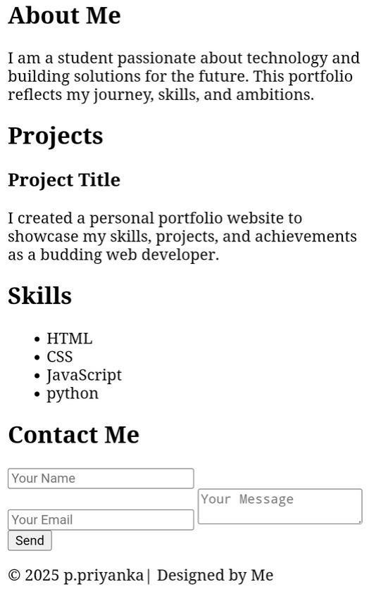
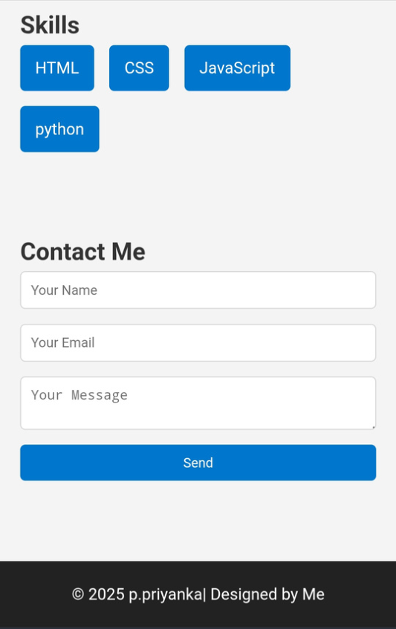
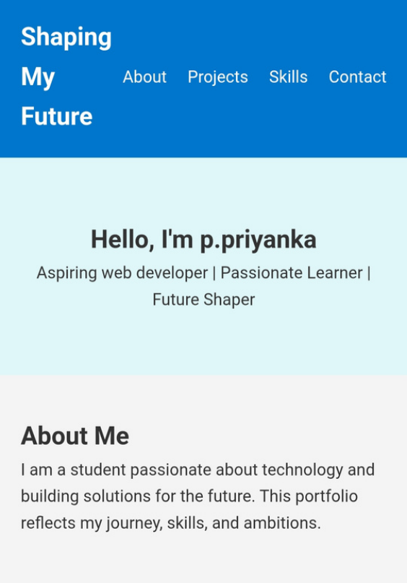
RESULTS AND SCREENSHOTS

Slide 11
CONCLUSION
Identified short-term and long-term career aspirations with actionable steps to achieve them.Outlined key skills I
aim to improve, including communication, leadership, and time management.
This portfolio reflects my commitment to personal and professional growth. By identifying my goals, strengths, and
next steps, I’m focused on continuous learning and building a future that aligns with my values and ambitions.
Shaping my future helps me grow into a responsible, skilled person who can contribute to society by making
positive changes and inspiring others to do the same.

